Slide 1

DEFECT DETECTION ON WELDED JOINTS USING ULTRASONIC TESTING
DEPARTMENT OF MECHANICAL ENGINEERING
Under the Guidance of
Dr. D. SUNEEL
M.Tech,Ph.D,
Professor & HOD
P.D.BHARATH CHANDAN
B.RAJESH
B.HEMANTH KUMAR
A.ADITHYA VARA PRASAD
M. SASI PAVAN
20471A0338
20471A0302
20471A0303
20471A0301
20471A0325

Slide 2
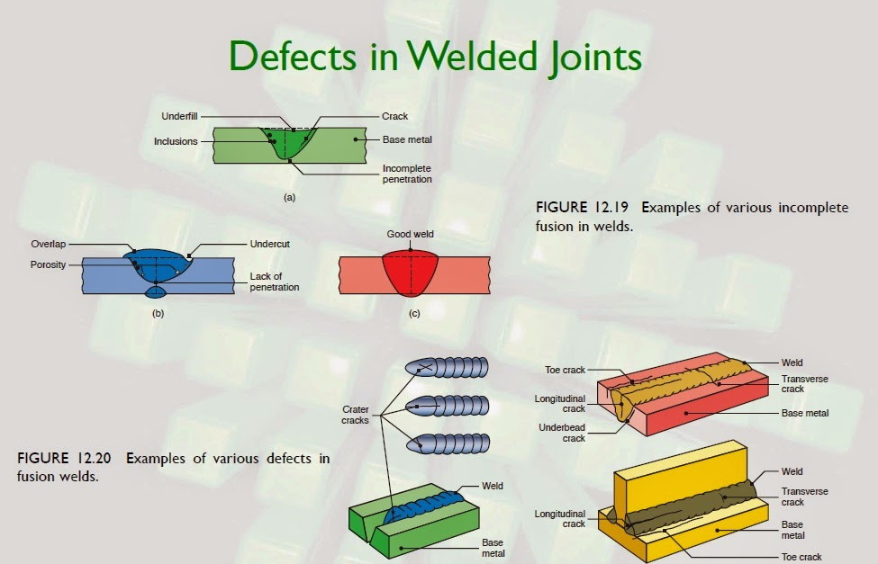
Introduction
Non-Destructive: Ultrasonic testing allows for the inspection of welded joints without causing any damage to the material.
Defect Detection: It is an effective method for detecting defects such as cracks, porosity, and voids in welded joints.
High-Frequency Sound Waves: Ultrasonic testing uses high-frequency sound waves to penetrate the material and identify defects.

Slide 3
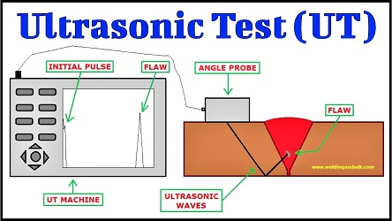
What Are ULTRASONTIC TESTING?
Ultrasonic testing is done in materials to determine whether there are flaws or defects present in a material, and also to determine the thickness of a material.
Ultrasonic testing methods use sound waves to find defects and measure thickness.
Ultrasonic Testing (UT) is also often called Ultrasonic Thickness Measurement (UTM), Ultrasonic Thickness Testing (UTT), or Sonic Testing (ST). It is most commonly used on metal, because metal conducts sound waves in a manner that supports this kind of measurement.
This method is commonly used by inspectors as one of many Non-Destructive Testing (NDT) testing methods.

Slide 4
Materials Used
1. Angular probe
2. Flaw detectors
3. Lubricant oil
4. Calibration blocks
5. Weldedtest specimens
6. surface preparation materials

Slide 5
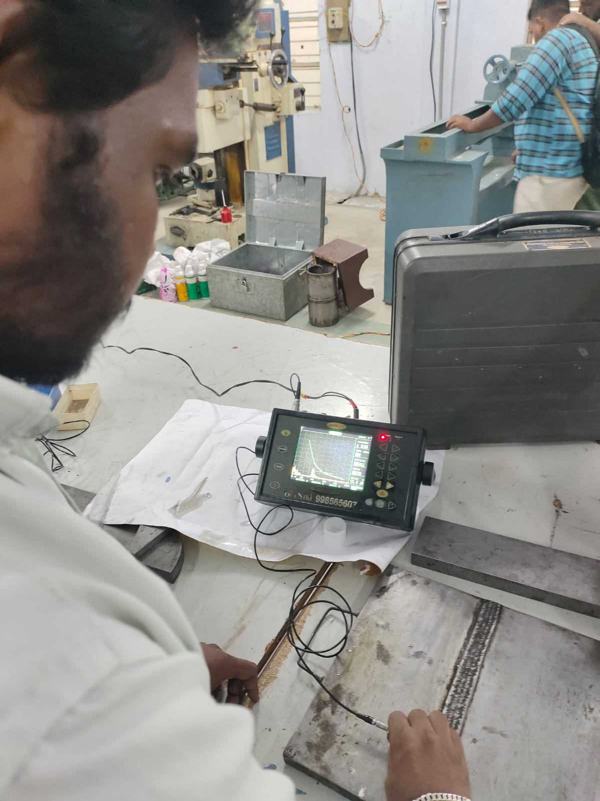
Project Overview
The project aims to perform ultrasonic testing (UT) on welded joints to detect and evaluate internal defects, discontinuities, and anomalies. Ultrasonic testing is a non-destructive testing (NDT) method widely used in industries such as manufacturing, construction, and aerospace to ensure the integrity and reliability of welded structures.

Slide 6
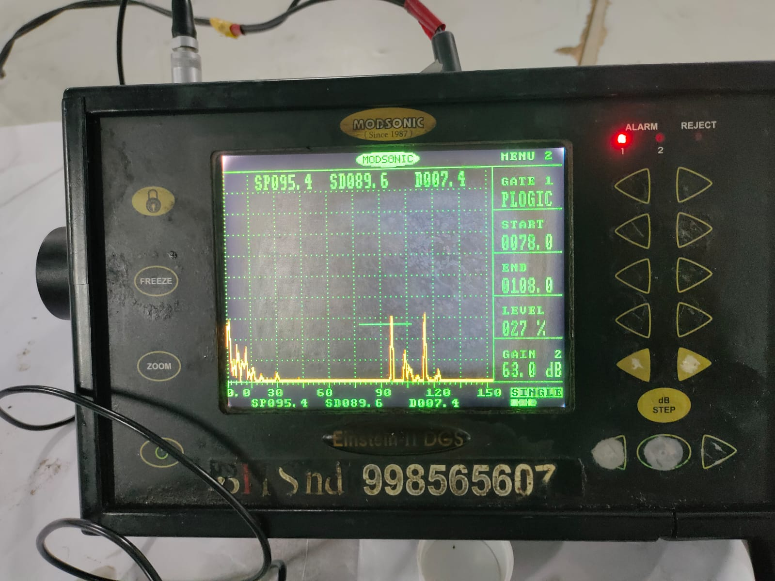
Working Principle
The working principle of ultrasonic testing (UT) on welded joints involves the transmission of high-frequency sound waves into the material being inspected and analyzing the reflections of these waves to detect internal defects or discontinuities within the weld.
ultrasonic testing on welded joints relies on the transmission, reflection, and analysis of high-frequency sound waves to detect and evaluate internal defects, ensuring the integrity and reliability of welded structures in various industries.

Slide 7
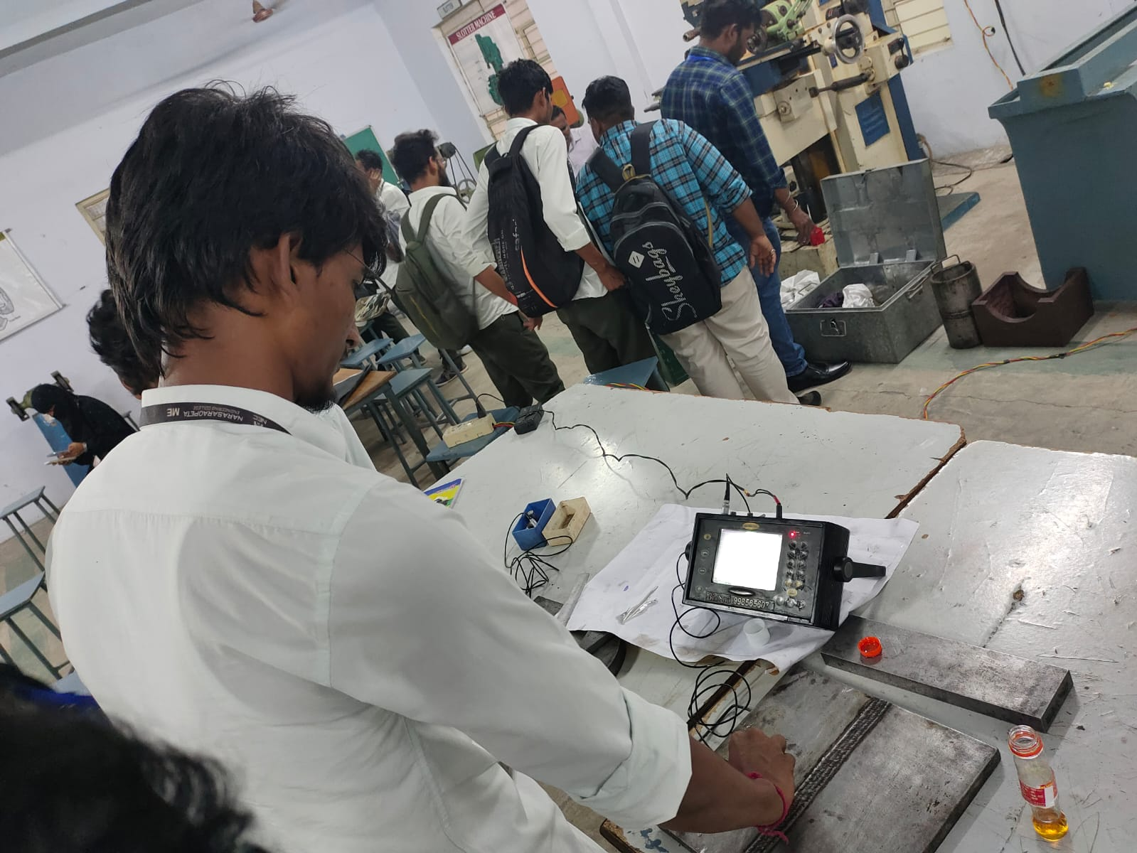
Benefits
Ultrasonic testing (UT) is a non-destructive method of inspecting welds. It uses high-frequency sound waves to evaluate the internal structure of weld joints and materials. UT can detect internal flaws, such as:
Cracks
Porosity
Lack of fusion
Inclusions
Voids
Undercutting
Longitudinal or transverse cracks

Slide 8
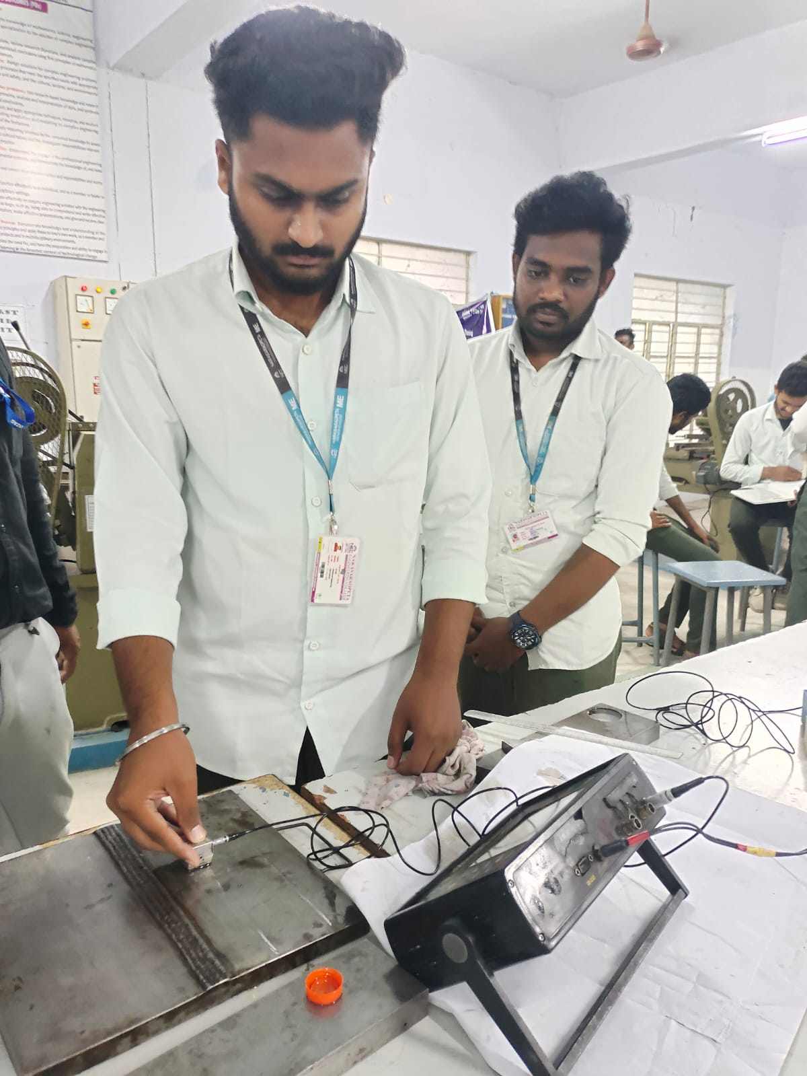
In conclusion
One of the most useful characteristics of ultrasonic testing is its ability to determine the exact position of a discontinuity in a weld. This testing method requires a high level of operator training and competence and is dependant on the establishment and application of suitable testing procedures..

Slide 9
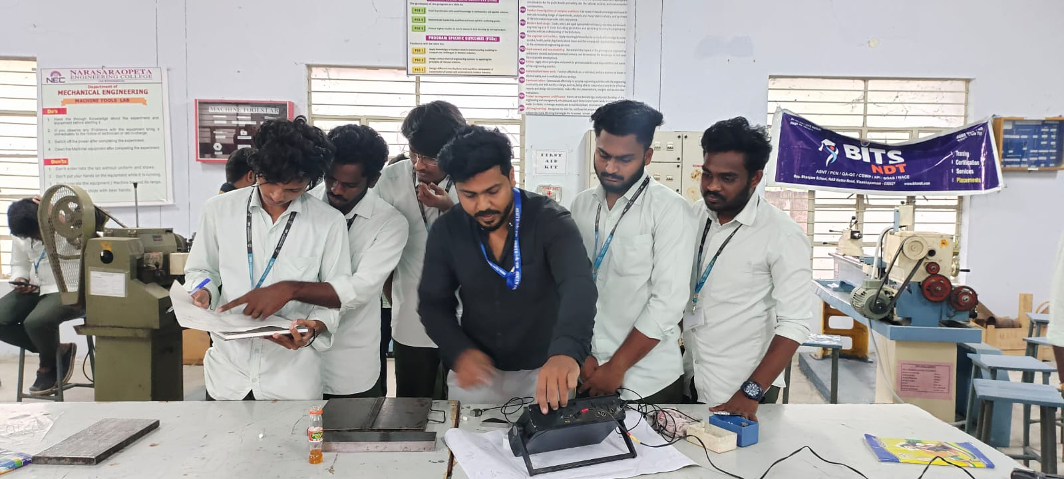
Working Photos

Slide 10
THANK YOU

